Slide 1
Unit-4
Hashing Techniques
Advanced Data structures Internet algorithms: Tries-Insert, Search operations and Delete operations.
Hashing Techniques- Dictionaries, Introduction to hash tables, Hash functions. Resolving collisions - Chaining, Open addressing - Linear Probing, Quadratic Probing, Double Hashing and Perfect Hashing.

Slide 2
Dictionary
Dictionary:
Dynamic-set data structure for storing items indexed using keys.
Supports operations Insert, Search, and Delete.
Applications:
Symbol table of a compiler.
Memory-management tables in operating systems.
Large-scale distributed systems.
Hash Tables:
Effective way of implementing dictionaries.
Generalization of ordinary arrays.

Slide 3
Special Case: Dictionaries
Dictionary = data structure that supports mainly two basic operations: insert a new item and return an item with a given key
Queries: return information about the set S:
Search (S, k)
Minimum (S), Maximum (S)
Successor (S, x), Predecessor (S, x)
Modifying operations: change the set
Insert (S, k)
Delete (S, k) – not very often

Slide 4
The Search Problem
Find items with keys matching a given search key
Given an array A, containing n keys, and a search key x, find the index i such as x=A[i]
As in the case of sorting, a key could be part of a large record.

Slide 5
Applications
Keeping track of customer account information at a bank
Search through records to check balances and perform transactions
Keep track of reservations on flights
Search to find empty seats, cancel/modify reservations
Search engine
Looks for all documents containing a given word

Slide 6
Direct-address Tables
Direct-address Tables are ordinary arrays.
Facilitate direct addressing.
Element whose key is k is obtained by indexing into the k^{th} position of the array.
Applicable when we can afford to allocate an array with one position for every possible key.
i.e. when the universe of keys U is small.
Dictionary operations can be implemented to take O(1) time.

Slide 7
Direct Addressing
Assumptions:
Key values are distinct
Each key is drawn from a universe U = {0, 1, . . . , m - 1}
Idea:
Store the items in an array, indexed by keys
Direct-address table representation:
An array T[0 . . . m - 1]
Each slot, or position, in T corresponds to a key in U
For an element x with key k, a pointer to x (or x itself) will be placed in location T[k]
If there are no elements with key k in the set, T[k] is empty, represented by NIL

Slide 8
Direct-address tables
S: student data
key: student ID number (SID)
name, e-mail, … (satellite data)
Assume: SID are integers in the range [0 … 1,000,000]
T
0
None
1
None
2
satellite data
Direct addressing use table T[0 .. 1,000,000]
3
None
satellite data
satellite data
satellite data
None
1,000,000
satellite data
None

Slide 9
Direct-address tables
S: set of elements
key: unique integer from the universe U= {0,…, M-1}
satellite data
use table (array) T[0..M-1] None if there is no element with key i in S
pointer to the satellite data if there is an element with key i in S
Analysis:
Search, Insert, Delete:
Space requirements:
T
0
None
1
None
2
satellite data
3
None
T[i] =
satellite data
satellite data
satellite data
O(1)
None
M-1
satellite data
O(M)
None

Slide 10
Direct-address tables
S: student data
key: student ID number (SID)
name, e-mail, … (satellite data)
Assume: SID are integers with 9 digits
➨ use table T[0 .. 999,999,999] ?!?
uses too much memory, most entries will be None …
if the universe U is large, storing a table of size |U| may be impractical or impossible
often the set K of keys actually stored is small, compared to U most of the space allocated for T is wasted.

Slide 11
Direct Addressing (cont’d)

Slide 12
Operations
Alg.: DIRECT-ADDRESS-SEARCH(T, k)
return T[k]
Alg.: DIRECT-ADDRESS-INSERT(T, x)
T[key[x]] ← x
Alg.: DIRECT-ADDRESS-DELETE(T, x)
T[key[x]] ← NIL
Running time for these operations: O(1)

Slide 13
Comparing Different Implementations
Implementing dictionaries using:
Direct addressing
Ordered/unordered arrays
Ordered/unordered linked lists
Insert
Search
direct addressing
O(1)
O(1)
ordered array
O(N)
O(lgN)
ordered list
O(N)
O(N)
unordered array
O(1)
O(N)
unordered list
O(1)
O(N)

Slide 14
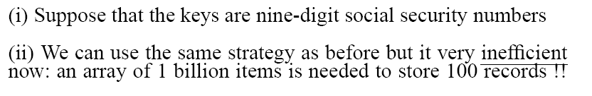
Examples Using Direct Addressing
Example 1:
Example 2:

Slide 15
Hash Tables
Notation:
U – Universe of all possible keys.
K – Set of keys actually stored in the dictionary.
|K| = n.
When U is very large,
Arrays are not practical.
|K| << |U|.
Use a table of size proportional to |K| – The hash tables.
However, we lose the direct-addressing ability.
Define functions that map keys to slots of the hash table.

Slide 16
Hash Tables
Idea:
Use a function h to compute the slot for each key
Store the element in slot h(k)
A hash function h transforms a key into an index in a hash table T[0…m-1]:
h : U → {0, 1, . . . , m - 1}
We say that k hashes to slot h(k)
Advantages:
Reduce the range of array indices handled: m instead of |U|
Storage is also reduced

Slide 17
Hash tables
S: student data
key = SID = integer from U = {0 .. 999,999,999}
Idea: use a smaller table, for example, T[0 .. 9,999,999] and use only 7 last digits to determine position
T
0
None
1
None
2
key = 130,000,003
3
None
key = 646,029,537
6,029,537
None
key = 740,000,003
9,999,999
None

Slide 18
Hash tables
S set of keys from the universe U = {0 .. M-1}
use a hash table T [0..m-1] (with m ≤ M)
use a hash function h : U → {0 … m-1} to determine the position of each key: key k hashes to slot h(k)
What is a good hash function?
How do we resolve collisions? (Two or more keys hash to the same slot.)
T
0
None
1
None
key = k; h(k) = i
2
3
None
i
None
m-1
None

Slide 19
Hash Tables
When K is much smaller than U, a hash table requires much less space than a direct-address table
Can reduce storage requirements to |K|
Can still get O(1) search time, but on the average case, not the worst case

Slide 20
Hashing
Hash function h: Mapping from U to the slots of a hash table T[0..m–1].
h : U → {0,1,…, m–1}
With arrays, key k maps to slot A[k].
With hash tables, key k maps or “hashes” to slot T[h[k]].
h[k] is the hash value of key k.

Slide 21
Issues with Hashing
Multiple keys can hash to the same slot – collisions are possible.
Design hash functions such that collisions are minimized.
But avoiding collisions is impossible.
Design collision-resolution techniques.
Search will cost Ө(n) time in the worst case.
However, all operations can be made to have an expected complexity of Ө(1).

Slide 22
Hashing
0
U
(universe of keys)
h(k₁)
h(k₄)
K
(actual
keys)
k₁
k₄
k₂
collision
h(k₂)=h(k₅)
k₅
k₃
h(k₃)
m–1

Slide 23
Revisit Example 2

Slide 24
Collisions
Two or more keys hash to the same slot!!
For a given set K of keys
If |K| ≤ m, collisions may or may not happen, depending on the hash function
If |K| > m, collisions will definitely happen (i.e., there must be at least two keys that have the same hash value)
Avoiding collisions completely is hard, even with a good hash function

Slide 25
Handling Collisions
Mechanisms for Handling Collisions:
Chaining
Open addressing
Linear probing
Quadratic probing
Double hashing

Slide 26
Collision Resolution by Chaining
0
U
(universe of keys)
h(k₁)=h(k₄)
X
k₁
k₄
K
(actual
keys)
k₂
k₆
X
h(k₂)=h(k₅)=h(k₆)
k₅
k₈
k₇
k₃
X
h(k₃)=h(k₇)
h(k₈)
m–1

Slide 27
Collision Resolution by Chaining
0
U
(universe of keys)
k₁
k₄
k₁
k₄
K
(actual
keys)
k₂
k₆
k₅
k₂
k₆
k₅
k₈
k₇
k₃
k₇
k₃
k₈
m–1

Slide 28
Hashing with Chaining
Dictionary Operations:
Chained-Hash-Insert (T, x)
Insert x at the head of list T[h(key[x])].
Worst-case complexity – O(1).
Chained-Hash-Delete (T, x)
Delete x from the list T[h(key[x])].
Worst-case complexity – proportional to length of list with singly-linked lists. O(1) with doubly-linked lists.
Chained-Hash-Search (T, k)
Search an element with key k in list T[h(k)].
Worst-case complexity – proportional to length of list.

Slide 29
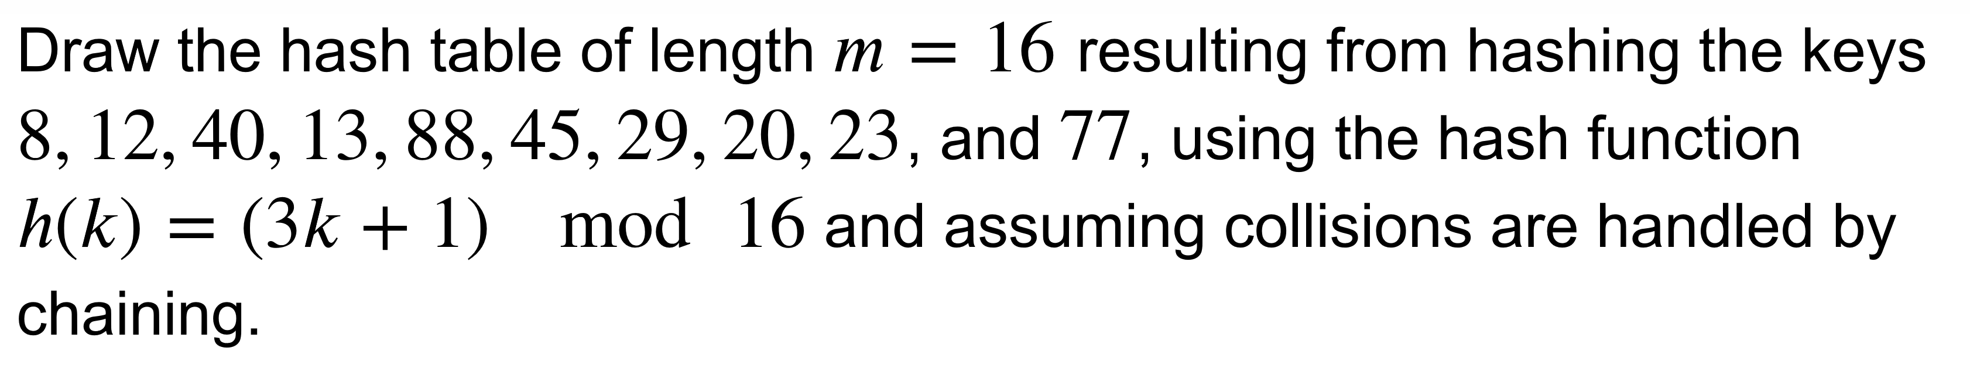
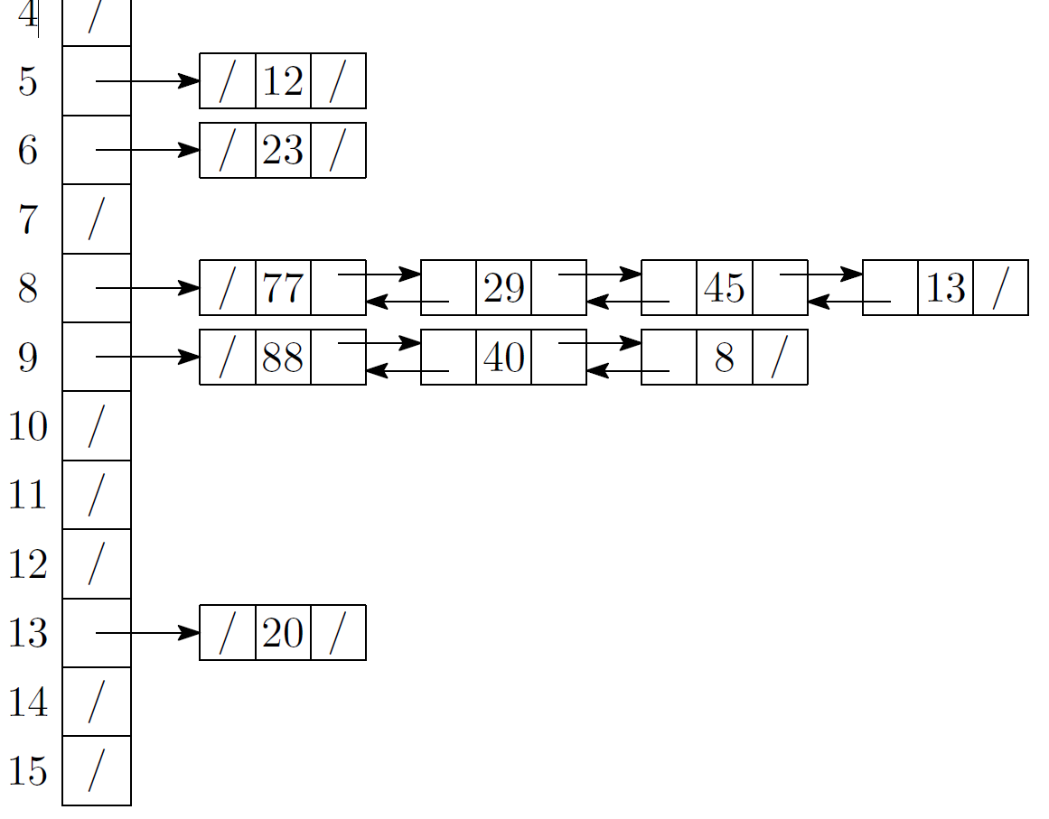
Exercise

Slide 30
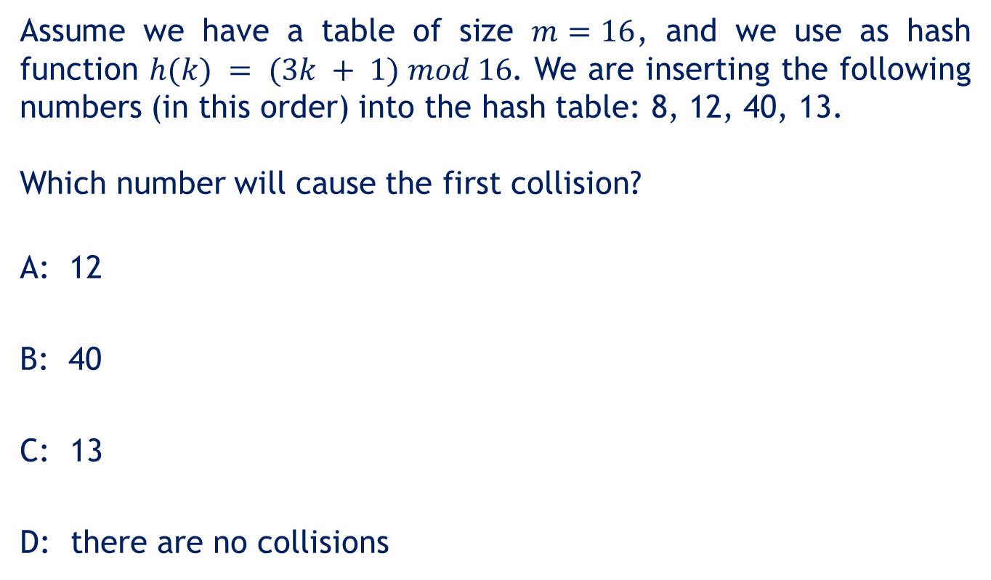
Quiz
Assume we have a table of size $m=16$, and we use as hash function $h(k) = (3k + 1) mod 16$. We are inserting the following numbers (in this order) into the hash table: 8, 12, 40, 13.
Which number will cause the first collision?
A: 12
B: 40
C: 13
D: there are no collisions

Slide 31
Analysis on Chained-Hash-Search
Load factor α=n/m = average keys per slot.
m – number of slots.
n – number of elements stored in the hash table.
Worst-case complexity: Θ(n) + time to compute h(k).
Assume
Simple uniform hashing.
Any key is equally likely to hash into any of the m slots, independent of where any other key hashes to.
O(1) time to compute h(k).
Time to search for an element with key k is Θ(|T[h(k)]|).
Expected length of a linked list = load factor = α = n/m.

Slide 32
Collision with Chaining - Discussion
Choosing the size of the table
Small enough not to waste space
Large enough such that lists remain short
Typically 1/5 or 1/10 of the total number of elements
How should we keep the lists: ordered or not?
Not ordered!
Insert is fast
Can easily remove the most recently inserted elements

Slide 33
Insertion in Hash Tables
Alg.: CHAINED-HASH-INSERT(T, x)
insert x at the head of list T[h(key[x])]
Worst-case running time is O(1)
Assumes that the element being inserted isn’t already in the list
It would take an additional search to check if it was already inserted

Slide 34
Deletion in Hash Tables
Alg.: CHAINED-HASH-DELETE(T, x)
delete x from the list T[h(key[x])]
Need to find the element to be deleted.
Worst-case running time:
Deletion depends on searching the corresponding list

Slide 35
Searching in Hash Tables
Alg.: CHAINED-HASH-SEARCH(T, k)
search for an element with key k in list T[h(k)]
Running time is proportional to the length of the list of elements in slot h(k)

Slide 36
Analysis of Hashing with Chaining: Worst Case
How long does it take to search for an element with a given key?
Worst case:
All n keys hash to the same slot
Worst-case time to search is Θ(n), plus time to compute the hash function
T
0
chain
m - 1

Slide 37
Load Factor of a Hash Table
Load factor of a hash table T:
α = n/m
n = # of elements stored in the table
m = # of slots in the table = # of linked lists
α encodes the average number of elements stored in a chain
α can be <, =, > 1
T
0
chain
chain
chain
chain
m - 1

Slide 38
Case 1: Unsuccessful Search (i.e., item not stored in the table)
Theorem
An unsuccessful search in a hash table takes expected time under the assumption of simple uniform hashing
(i.e., probability of collision Pr(h(x)=h(y)), is 1/m)
Proof
Searching unsuccessfully for any key k
need to search to the end of the list T[h(k)]
Expected length of the list:
E[n_{h(k)}] = α = n/m
Expected number of elements examined in an unsuccessful search is α
Total time required is:
O(1) (for computing the hash function) + α →

Slide 39
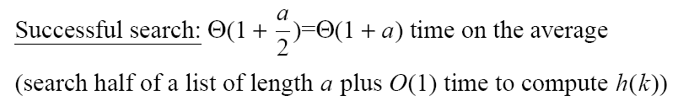
Case 2: Successful Search
A successful search takes expected time Θ(1+α).

Slide 40
Analysis of Search in Hash Tables
If m (# of slots) is proportional to n (# of elements in the table):
n = O(m)
α = n/m = O(m)/m = O(1)
⇒ Searching takes constant time on average

Slide 41
Expected Cost – Interpretation
If n = O(m), then α=n/m = O(m)/m = O(1).
⇒ Searching takes constant time on average.
Insertion is O(1) in the worst case.
Deletion takes O(1) worst-case time when lists are doubly linked.
Hence, all dictionary operations take O(1) time on average with hash tables with chaining.

Slide 42
Good Hash Functions
Satisfy the assumption of simple uniform hashing.
Not possible to satisfy the assumption in practice.
Often use heuristics, based on the domain of the keys, to create a hash function that performs well.
Regularity in key distribution should not affect uniformity. Hash value should be independent of any patterns that might exist in the data.
E.g. Each key is drawn independently from U according to a probability distribution P:
∑_{k: h(k) = j} P(k) = 1/m for j = 0, 1, … , m–1.
An example is the division method.

Slide 43
Keys as Natural Numbers
Hash functions assume that the keys are natural numbers.
When they are not, have to interpret them as natural numbers.
Example: Interpret a character string as an integer expressed in some radix notation. Suppose the string is CLRS:
ASCII values: C=67, L=76, R=82, S=83.
There are 128 basic ASCII values.
So, CLRS = 67·128³+76 ·128²+ 82·128¹+ 83·128⁰ = 141,764,947.

Slide 44
Division Method
Map a key k into one of the m slots by taking the remainder of k divided by m. That is,
h(k) = k mod m
Example: m = 31 and k = 78 ⇒ h(k) = 16.
Advantage: Fast, since requires just one division operation.
Disadvantage: Have to avoid certain values of m.
Don’t pick certain values, such as m=2^{p}
Or hash won’t depend on all bits of k.
Good choice for m:
Primes, not too close to power of 2 (or 10) are good.

Slide 45
Multiplication Method
If 0 < A < 1, h(k) = ⎣m (kA mod 1)⎦ = ⎣m (kA – ⎣kA⎦) ⎦
where kA mod 1 means the fractional part of kA, i.e., kA – ⎣kA⎦.
Disadvantage: Slower than the division method.
Advantage: Value of m is not critical.
Typically chosen as a power of 2, i.e., m = 2^{p}, which makes implementation easy.
Example: m = 1000, k = 123, A ≈ 0.6180339887…
h(k) = ⎣1000(123 · 0.6180339887 mod 1)⎦
= ⎣1000 · 0.018169... ⎦ = 18.

Slide 46
How to choose A?
How to choose A?
The multiplication method works with any legal value of A.
But it works better with some values than with others, depending on the keys being hashed.
Knuth suggests using A ≈ (√5 – 1)/2.

Slide 47
Open Addressing
If we have enough contiguous memory to store all the keys (m > N) ⇒ store the keys in the table itself
No need to use linked lists anymore
Basic idea:
Insertion: if a slot is full, try another one,
until you find an empty one
Search: follow the same sequence of probes
Deletion: more difficult ... (we’ll see why)
Search time depends on the length of the
probe sequence!
e.g., insert 14

Slide 48
Generalize hash function notation:
A hash function contains two arguments now:
(i) Key value, and (ii) Probe number
h(k,p), p=0,1,...,m-1
Probe sequences
<h(k,0), h(k,1), ..., h(k,m-1)>
Must be a permutation of <0,1,...,m-1>
There are m! possible permutations
Good hash functions should be able to
produce all m! probe sequences
insert 14
Example
<1, 5, 9>

Slide 49
Common Open Addressing Methods
Linear probing
Quadratic probing
Double hashing
Note: None of these methods can generate more than m² different probing sequences!

Slide 50
Linear probing: Inserting a key
Idea: when there is a collision, check the next available position in the table (i.e., probing)
h(k,i) = (h₁(k) + i) mod m
i=0,1,2,...
First slot probed: h₁(k)
Second slot probed: h₁(k) + 1
Third slot probed: h₁(k)+2, and so on
Can generate m probe sequences maximum, why?
probe sequence: < h1(k), h1(k)+1 , h1(k)+2 , ....>
wrap around

Slide 51
Linear probing: Searching for a key
Three cases:
(1) Position in table is occupied with an element of equal key
(2) Position in table is empty
(3) Position in table occupied with a different element
Case 2: probe the next higher index until the element is found or an empty position is found
The process wraps around to the beginning of the table
0
h(k₁)
h(k₄)
h(k₂) = h(k₅)
h(k₃)
m - 1

Slide 52
Linear probing: Deleting a key
Problems
Cannot mark the slot as empty
Impossible to retrieve keys inserted after that slot was occupied
Solution
Mark the slot with a sentinel value DELETED
The deleted slot can later be used for insertion
Searching will be able to find all the keys
0
m - 1

Slide 53
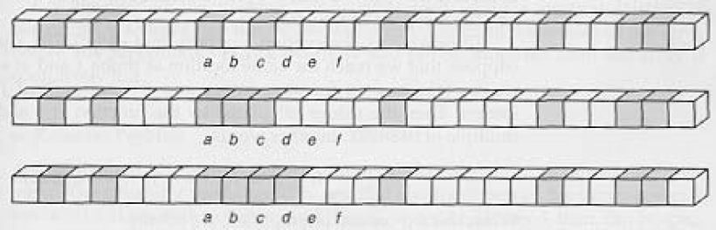
Primary Clustering Problem
Some slots become more likely than others
Long chunks of occupied slots are created
⇒ search time increases!!
initially, all slots have probability 1/m
Slot b:
2/m
Slot d:
4/m
Slot e:
5/m

Slide 54
Linear Probing
h(k, i) = (h′(k)+i) mod m.
The initial probe determines the entire probe sequence.
T[h′(k)], T[h′(k)+1], …, T[m–1], T[0], T[1], …, T[h′(k)–1]
Hence, only m distinct probe sequences are possible.
Suffers from primary clustering:
Long runs of occupied sequences build up.
Long runs tend to get longer, since an empty slot preceded by i full slots gets filled next with probability (i+1)/m.
Hence, average search and insertion times increase.
key
Probe number
Auxiliary hash function

Slide 55
Linear Probing-Examples
Example:
18 %13 =5
41%13=2
22%13=9
44%13=5 (occupied) move to 6
59%13=7
32%13=6 (occupied) move to 8
31%13=5 (occupied) move to 10
73%13=10 (occupied) move to 11
h(x) = x mod 13
Insert keys 18, 41, 22, 44, 59, 32, 31, 73, in this order
Linear probing handles collisions by placing the colliding item in the next (circularly) available table cell.
Each table cell inspected is referred to as a probe.
Colliding items lump together, causing future collisions to cause a longer sequence of probes.
0
1
2
3
4
5
6
7
8
9
10
11
12
41
18
44
59
32
22
31
73
0
1
2
3
4
5
6
7
8
9
10
11
12

Slide 56
Search with Linear Probing
Consider a hash table A that uses linear probing
get(k)
We start at cell h(k)
We probe consecutive locations until one of the following occurs
An item with key k is found, or
An empty cell is found, or
N cells have been unsuccessfully probed
To ensure the efficiency, if k is not in the table, we want to find an empty cell as soon as possible. The load factor can NOT be close to 1.
Algorithm get(k)
i ← h(k)
p ← 0
repeat
c ← A[i]
if c = ∅
return null
else if c.key () = k
return c.element()
else
i ← (i + 1) mod N
p ← p + 1
until p = N
return null

Slide 57
Linear Probing
Search for key=20.
h(20)=20 mod 13 =7.
Go through rank 8, 9, …, 12, 0.
Search for key=15
h(15)=15 mod 13=2.
Go through rank 2, 3 and return null.
Example:
h(x) = x mod 13
Insert keys 18, 41, 22, 44, 59, 32, 31, 73, 12, 20 in this order
0
1
2
3
4
5
6
7
8
9
10
11
12
20
41
18
44
59
32
22
31
73
12
0
1
2
3
4
5
6
7
8
9
10
11
12

Slide 58
Quadratic Probing
Primary clustering occurs with linear probing because the same linear pattern:
if a bin is inside a cluster, then the next bin must either:
also be in that cluster, or
expand the cluster
Instead of searching forward in a linear fashion, try to jump far enough out of the current (unknown) cluster.

Slide 59
Quadratic Probing
h(k,i) = (h′(k) + c₁i + c₂i²) mod m c₁≠ c₂
The initial probe position is T[h′(k)], later probe positions are offset by amounts that depend on a quadratic function of the probe number i.
Must constrain c₁, c₂, and m to ensure that we get a full permutation of ⟨0, 1,…, m–1⟩.
Can suffer from secondary clustering:
If two keys have the same initial probe position, then their probe sequences are the same.
key
Probe number
Auxiliary hash function

Slide 60
Quadratic Probing
Consider a hash function h’(x) : U → {0, 1, . . ., m – 1}.
In open addressing scheme, the actual hash function h(x) is taking the hash function h’(x) and attach some another part with it to make one quadratic equation.
ℎ´(𝑥) = 𝑥 𝑚𝑜𝑑 𝑚
ℎ(𝑥, 𝑖) = (ℎ´(𝑥) + 𝑖²) 𝑚𝑜𝑑 𝑚
We can put some other quadratic equations also using some constants
The value of i = 0, 1, . . ., m – 1.
So we start from i = 0, and increase this until we get one free space.
So initially when i = 0, then the h(x, i) is same as h´(x).

Slide 61
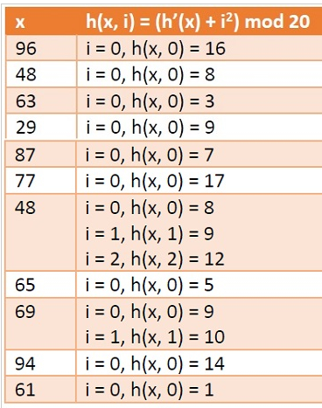
Example
Consider a list of size 20 (m = 20).
The elements are {96, 48, 63, 29, 87, 77, 48, 65, 69, 94, 61}
ℎ´(𝑥) = 𝑥 𝑚𝑜𝑑 𝑚
ℎ(𝑥, 𝑖) = (ℎ´(𝑥) + 𝑖²) 𝑚𝑜𝑑 𝑚
where i = 0, 1, . . ., m – 1
h(x, i)=(h´(x) + 1²)mod m, (h´(x) + 2²)mod m, (h´(x) + 3²)mod m (h´(x) + 4²)mod m, (h´(x) + 5²)mod m, ...

Slide 62
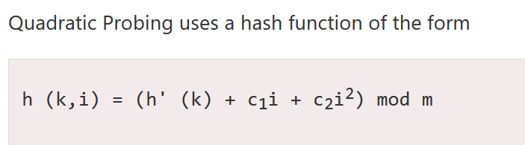
Where (as in linear probing) h' is an auxiliary hash function c₁, c₂ ≠0 are auxiliary constants and i=0, 1...m-1.
The initial position is T [h' (k)]; later position probed is offset by the amount that depend in a quadratic manner on the probe number i.

Slide 63
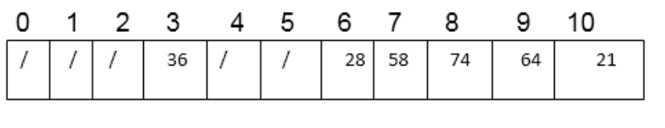
Example
Consider inserting the keys 74, 28, 36,58,21,64 into a hash table of size m =11 using quadratic probing with c₁=1 and c₂=3. Further consider that the primary hash function is h' (k) = k mod m.
Final Answer

Slide 64
Example
Here c₁= 1 and c₂=3 h (k, i) = [k mod m + i + 3i² ] mod m
Insert 74. h (74,0)= (74 mod 11+0+3x0) mod 11 = (8 +0+0) mod 11 = 8 T [8] is free; insert the key 74 at this place.
Insert 28. h (28, 0) = (28 mod 11 + 0 + 3 x 0) mod 11 = (6 +0 + 0) mod 11 = 6. T [6] is free; insert key 28 at this place.
Insert 36. h (36, 0) = (36 mod 11 + 0 + 3 x 0) mod 11 = (3 + 0+0) mod 11=3 T [3] is free; insert key 36 at this place.
Insert 58. h (58, 0) = (58 mod 11 + 0 + 3 x 0) mod 11 = (3 + 0 + 0) mod 11 = 3 T [3] is not free, so next probe sequence is computed as h (59, 1) = (58 mod 11 + 1 + 3 x1²) mod 11 = (3 + 1 + 3) mod 11 =7 mod 11= 7 T [7] is free; insert key 58 at this place.
Insert 21. h (21, 0) = (21 mod 11 + 0 + 3 x 0) = (10 + 0) mod 11 = 10 T [10] is free; insert key 21 at this place.
Insert 64. h (64, 0) = (64 mod 11 + 0 + 3 x 0) = (9 + 0+ 0) mod 11 = 9. T [9] is free; insert key 64 at this place.

Slide 65
Secondary Clustering
The phenomenon of primary clustering will not occur with quadratic probing
However, if multiple items all hash to the same initial bin, the same sequence of numbers will be followed
This is termed secondary clustering
The effect is less significant than that of primary clustering

Slide 66
Double Hashing
h(k,i) = (h₁(k) + i h₂(k)) mod m
Two auxiliary hash functions.
h₁ gives the initial probe. h₂ gives the remaining probes.
Must have h₂(k) relatively prime to m, so that the probe sequence is a full permutation of ⟨0, 1,…, m–1⟩.
Choose m to be a power of 2 and have h₂(k) always return an odd number. Or,
Let m be prime, and have 1 < h₂(k) < m.
Θ(m²) different probe sequences.
One for each possible combination of h₁(k) and h₂(k).
Close to the ideal uniform hashing.
key
Probe number
Auxiliary hash functions

Slide 67
Double Hashing
Use one hash function to determine the first slot
(2) Use a second hash function to determine the increment for the probe sequence
h(k,i) = (h₁(k) + i h₂(k) ) mod m, i=0,1,...
Initial probe: h₁(k)
Second probe is offset by h₂(k) mod m, so on ...
Advantage: avoids clustering
Disadvantage: harder to delete an element
Can generate m² probe sequences maximum

Slide 68
Double Hashing: Example
h₁(k) = k mod 13
h₂(k) = 1+ (k mod 11)
h(k,i) = (h₁(k) + i h₂(k)) mod 13
Insert key 14:
h₁(14,0) = 14 mod 13 = 1
h(14,1) = (h₁(14) + h₂(14)) mod 13
= (1 + 4) mod 13 = 5
h(14,2) = (h₁(14) + 2 h₂(14)) mod 13
= (1 + 8) mod 13 = 9
0
79
69
98
72
50
1
2
3
4
5
6
7
8
9
14
10
11
12

Slide 69
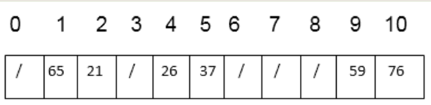
Example Double Hashing
Consider inserting the keys 76, 26, 37,59,21,65 into a hash table of size m = 11 using double hashing. Consider that the auxiliary hash functions are h₁(k)=k mod 11 and h₂(k) = k mod 9.
Insert 76. h₁(76) = 76 mod 11 = 10 h₂(76) = 76 mod 9 = 4 h (76, 0) = (10 + 0 x 4) mod 11 = 10 mod 11 = 10 T [10] is free, so insert key 76 at this place.
Insert 26. h₁(26) = 26 mod 11 = 4 h₂(26) = 26 mod 9 = 8 h (26, 0) = (4 + 0 x 8) mod 11 = 4 mod 11 = 4 T [4] is free, so insert key 26 at this place
Insert 37. h₁(37) = 37 mod 11 = 4 h₂(37) = 37 mod 9 = 1 h (37, 0) = (4 + 0 x 1) mod 11 = 4 mod 11 = 4 T [4] is not free, the next probe sequence is h (37, 1) = (4 + 1 x 1) mod 11 = 5 mod 11 = 5 T [5] is free, so insert key 37 at this place
Insert 59. h₁(59) = 59 mod 11 = 4 h₂(59) = 59 mod 9 = 5 h (59, 0) = (4 + 0 x 5) mod 11 = 4 mod 11 = 4 Since, T [4] is not free, the next probe sequence is h (59, 1) = (4 + 1 x 5) mod 11 = 9 mod 11 = 9 T [9] is free, so insert key 59 at this place.
Insert 21. h₁(21) = 21 mod 11 = 10 h₂(21) = 21 mod 9 = 3 h (21, 0) = (10 + 0 x 3) mod 11 = 10 mod 11 = 10 T [10] is not free, the next probe sequence is h (21, 1) = (10 + 1 x 3) mod 11 = 13 mod 11 = 2 T [2] is free, so insert key 21 at this place.
Insert 65. h₁(65) = 65 mod 11 = 10 h₂(65) = 65 mod 9 = 2 h (65, 0) = (10 + 0 x 2) mod 11 = 10 mod 11 = 10 T [10] is not free, the next probe sequence is h (65, 1) = (10 + 1 x 2) mod 11 = 12 mod 11 = 1 T [1] is free, so insert key 65 at this place

Slide 70
Analysis of Open Addressing
(load factor)
k=0

Slide 71
Analysis of Open-address Hashing
Analysis is in terms of load factor α.
Assumptions:
Assume that the table never completely fills, so n <m and α < 1. Why?
Assume uniform hashing.
No deletion.
In a successful search, each key is equally likely to be searched for.

Slide 72
To ensure there are no collisions in the secondary hash table S_{j}, we need to make the size m_{j} of the secondary table equal to the square of the number of keys hashing into slot j in the first table. That is:
m_{j} = n_{j}²
The hash functions for the primary hash table is carefully chosen so that we limit the expected total amount of space used to be O(n). Take some time to watch the video explanation of Perfect Hashing.

Slide 73
Perfect Hashing
Perfect hashing is implemented using two hash tables, one at each level. Each of the table uses universal hashing.
The first level is the same a hashing with chaining such that n elements is hashed into m slots in the hash table.
This is done using a has function selected from a universal family of hash functions.
The second level of uses a second hash table (instead of a linked list used in chaining).
Elements that hash to the same slot j in the first hash table are stored in a second hash table.
This second hash table is known as secondary hash table.
The hash function h_{j} is carefully chosen such that there are no collision in the secondary table.

Slide 74
Perfect Hashing
If you know the n keys in advance, make a hash table with O(n) size, and worst-case O(1) lookup time!
Just use two levels of hashing: A table of size n, then tables of size n_{j}².
k₁
k₄
k₂
k₅
k₇
k₆
k₈
k₃

Slide 75
Perfect Hashing-Implementation
In the static case, we are provided a set with a total of p entries, each one associated with a unique key, ahead of time. Select a first-level hash table with size s = 2(p-1) buckets.
To construct, p entries are separated into q buckets by the top-level hashing function, where q = 2(p-1).
Then for each bucket with r entries, a second-level table is allocated with r2 slots, and its hash function is chosen at random from a universal hash function set so that it becomes collision-free and stored alongside the hash table.
If the hash function randomly chosen creates a table with collisions, a new hash function is randomly chosen until a collision-free table can be guaranteed.
At last, with the collision-free hash, the r entries are hashed into the second-level table.

